Slide 1
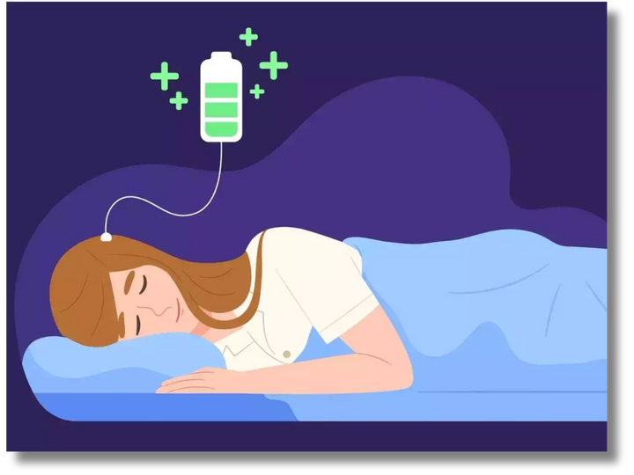
Sleep Sense
-UNVEILING THE SECRETS OF SLEEP AND LIFESTYLE
Done By
Naga Charitavya.M
Ap21110010027

Slide 2
03
ABSTRACT
04
INTRODUCTION
05
HYPOTHESIS
LIST OF CONTENTS
06
SYSTEM REQURIMENTS
07
USES OF DATA SET
08
SUGGESTIONS
09
VISUALISATION
10
ADVANTAGES
11
CONCLUSION

Slide 3
Abstract
"Sleep Sense: Unveiling the Secrets of Lifestyle" is a comprehensive review exploring the intricate relationship between lifestyle and sleep patterns. It delves into factors impacting sleep, such as physical activity, nutrition, stress management, technology usage, and work-life balance. The paper aims to offer strategies to optimize sleep patterns and overall well-being by examining lifestyle choices' interactions with sleep quality.
The role of circadian rhythms and chronotypes in shaping sleep-wake cycles is investigated, providing insights into personalized sleep approaches. Additionally, the impact of modern elements like screen time and social media on sleep disruption and its health implications is discussed.
By amalgamating the latest research, "Sleep Sense" provides a holistic perspective on understanding the balance between lifestyle choices and sleep health. It serves as a valuable resource for researchers, healthcare professionals, and individuals seeking evidence-based practices to improve sleep quality and lead healthier, more fulfilling lives.

Slide 4
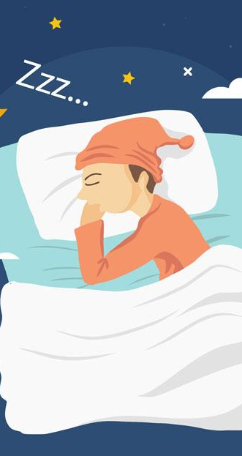
Introduction
"SleepSense: Unveiling the Secrets of Lifestyle and Adaptation" is a comprehensive study that delves into the intricate relationship between lifestyle choices, sleep quality, and adaptation. The research aims to shed light on how various lifestyle factors, including nutrition, physical activity, stress management, and technology usage, impact the sleep-wake cycle and how individuals adapt their sleep behaviors to cope with changing circumstances.
In today's modern world, the boundaries between work, leisure, and rest have become blurred due to advancements in technology. As a result, maintaining a healthy balance between lifestyle and sleep has become increasingly challenging, leading to a rise in sleep-related issues. Therefore, understanding the factors contributing to sleep disorders is crucial for devising effective interventions.
Through the synthesis of existing research and empirical evidence, SleepSense offers evidence-based insights and practical recommendations for improving sleep health and fostering adaptability amidst evolving lifestyles. The subsequent sections of the study will explore the latest findings in sleep science, addressing how lifestyle choices influence sleep quality, the role of individual differences in circadian rhythms and chronotypes, and the importance of adaptation in maintaining optimal sleep patterns.
By contributing to the growing body of knowledge in sleep research, SleepSense aims to assist individuals and healthcare professionals in promoting better sleep and overall well-being in an increasingly dynamic and demanding world.

Slide 5

Hypothesis
The lifestyle choices and habits of individuals significantly influence their sleep patterns and overall sleep quality.
In this project, the hypothesis might be tested by analyzing data on various lifestyle factors, such as nutrition, physical activity, stress levels, technology usage, and work-life balance, and their correlation with sleep-related outcomes. The project may aim to identify which lifestyle choices have the most significant impact on sleep quality and how individuals can adapt their lifestyles to improve their sleep patterns. The findings from this analysis could provide valuable insights and evidence-based recommendations for promoting better sleep health and overall well-being.

Slide 6





SystemRequirements
SOFTWARE:
EXCEL SHEET
JUPYTER NOTEBOOK
(FOR CSV DATA)
(FOR ANALYSING DATA AND VISUALISING DATA)
HARDWARE:
CPU
MEMORY
(INTEL CORE i5 or MORE)
(8 GB RAM)
STORAGE
(500 GB INTERNAL STORAGE)

Slide 7
Based on the given dataset, we have this uses:
1. Person ID: Unique identifier for each person.
2. Gender: The gender of the individual (Male/Female).
3. Age: Age of the person.
4. Occupation: The profession or job of the individual.
5. Sleep Duration: Duration of sleep in hours.
6. Quality of Sleep: Subjective rating of sleep quality (usually on a scale).
7. Physical Activity Level: Level of physical activity (possibly measured in minutes or hours).
8. Stress Level: Subjective rating of stress level (possibly on a scale).
9. BMI Category: Body Mass Index category of the person (Normal, Overweight, Obese).
10. Blood Pressure: Blood pressure readings (Systolic/Diastolic).
11. Heart Rate: Heart rate (beats per minute).
12. Daily Steps: Number of steps taken daily.
13. Sleep Disorder: Any sleep disorder the person may have (Sleep Apnea, Insomnia, None).
Uses of
Dataset

Slide 8
The "SleepSense: Unveiling the Secrets of Sleep and Lifestyle" project can benefit from several valuable suggestions to enhance its impact and scope:
1. Longitudinal Study: Conduct a long-term study to track individuals' sleep patterns and lifestyle choices, providing insights into the long-lasting effects and adaptations.
2. Interventional Study: Implement interventions to evaluate how specific lifestyle changes impact sleep quality, offering practical guidance for improving sleep habits.
3. Sleep Hygiene Education: Develop educational materials to promote healthy sleep practices and assess their effectiveness in improving participants' sleep habits.
4. Comparative Analysis: Compare sleep and lifestyle patterns across different demographic groups to identify tailored approaches for specific populations.
5. Sleep Technology Assessment: Investigate the impact of sleep-related technologies on sleep quality, aiding in understanding their benefits and limitations.
6. Workplace Sleep Programs: Collaborate with organizations to promote healthy sleep habits among employees and assess the impact on well-being and productivity.
Suggestions

Slide 9
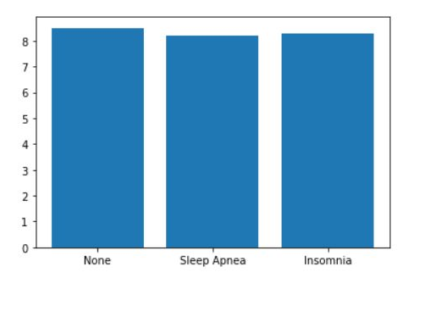
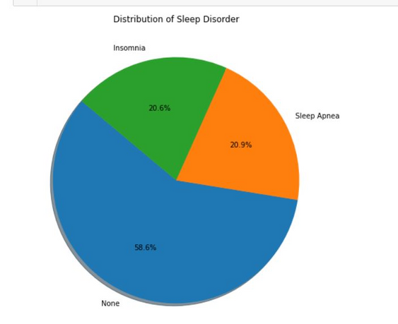
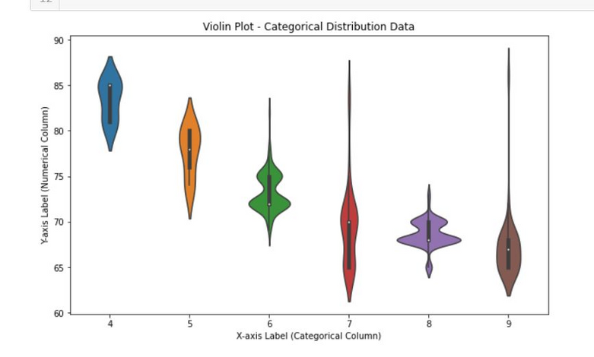
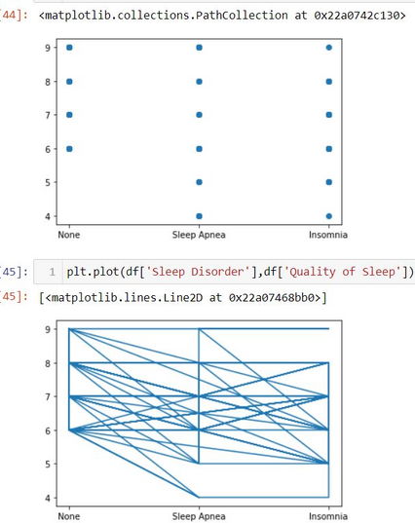
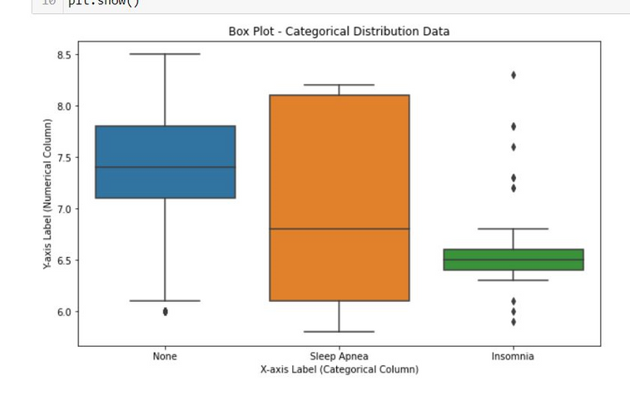
Visualisation

Slide 10
1. Improved Sleep Quality: "SleepSense" offers evidence-based insights and recommendations to optimize sleep quality. By understanding the intricate relationship between lifestyle choices and sleep patterns, individuals can make informed changes to their routines and environments, leading to better and more restorative sleep.
2. Health Benefits: Quality sleep is essential for overall health and contributes to improved cognitive function, immune system support, and emotional well-being. By unveiling the secrets of sleep and lifestyle, "SleepSense" empowers individuals to take proactive steps in improving their health through better sleep practices.
3. Personalized Approaches: The project likely explores the significance of individual differences in sleep needs, circadian rhythms, and chronotypes. By recognizing the importance of personalized sleep strategies, "SleepSense" enables individuals to tailor their sleep routines to suit their unique biological characteristics.
4. Stress Reduction: Understanding the impact of lifestyle factors on sleep allows individuals to address stressors that may disrupt their sleep patterns. Implementing stress management techniques can lead to reduced stress levels and improved sleep quality.
5. Enhanced Productivity and Performance: Better sleep has been linked to increased productivity, focus, and cognitive performance. "SleepSense" empowers individuals to make lifestyle adjustments that support optimal functioning during waking hours.
6. Preventing Sleep Disorders: By identifying factors that contribute to sleep disturbances, "SleepSense" helps individuals recognize potential risk factors for sleep disorders. Early intervention and lifestyle modifications may help prevent or manage sleep-related issues.
7. Holistic Well-Being: The project's focus on lifestyle and sleep highlights the importance of considering sleep as an integral part of overall well-being. By adopting healthy lifestyle choices, individuals can achieve a more balanced and fulfilling life.
Advantages

Slide 11
In conclusion, "SleepSense: Unveiling the Secrets of Sleep and Lifestyle" is a comprehensive and valuable project that sheds light on the intricate relationship between lifestyle choices and sleep patterns. Through a rigorous exploration of the latest research in sleep science and lifestyle factors, this project has provided evidence-based insights and practical recommendations to optimize sleep quality and overall well-being.
By understanding the impact of various lifestyle elements, such as nutrition, physical activity, stress management, and technology usage, on sleep health, individuals can make informed decisions to improve their sleep habits. The project emphasizes the importance of personalized approaches to sleep, considering individual differences in circadian rhythms and chronotypes.
The insights gained from "SleepSense" not only lead to improved sleep quality but also contribute to better overall health, productivity, and emotional well-being. By addressing stressors and adopting healthier lifestyle choices, individuals can achieve a more balanced and fulfilling life, positively impacting their performance during waking hours.
Moreover, "SleepSense" highlights the importance of considering sleep as a critical component of holistic well-being. Quality sleep is not only essential for physical health but also for cognitive function and emotional resilience. By prioritizing sleep and making positive changes to sleep habits, individuals can enhance their overall quality of life.
Conclusion

Slide 12
ThankYouu

